Slide 1



A bird’s eye view on my research interests so far
Nov 22, 2024
Elvio A. Blini
elvioadalberto.blini@unifi.it

Slide 2




2011
2012
2013 (-2016)
2015
2016 (-2020)
2020(-2022)
2023
M.Sc. Psychology (Neuropsychology) University of Milan – Bicocca
Clinical Research Assistant Italian Auxological Institute, Milan
Ph.D., Psychology University of Padua
Visiting Ph.D. student INSERM U1028 & University of Lyon
PRESTIGE + MSCA Fellow INSERM U1028 & University of Lyon
Senior (type B) Postdoc Fellow University of Padua
RTDa University of Florence

Slide 3
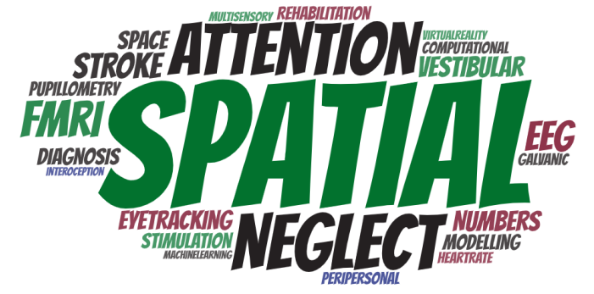
2011
2012
2013 (-2016)
2015
2016 (-2020)
2020(-2022)
2023
M.Sc. Psychology (Neuropsychology) University of Milan – Bicocca
Clinical Research Assistant Italian Auxological Institute, Milan
Ph.D., Psychology University of Padua
Visiting Ph.D. student INSERM U1028 & University of Lyon
PRESTIGE + MSCA Fellow INSERM U1028 & University of Lyon
Senior (type B) Postdoc Fellow University of Padua
RTDa University of Florence
Numbers and Space
Spatial Neglect
Machine learning for neuroimaging
Peripersonal Space
Pupillometry
Interoception and motivation

Slide 4

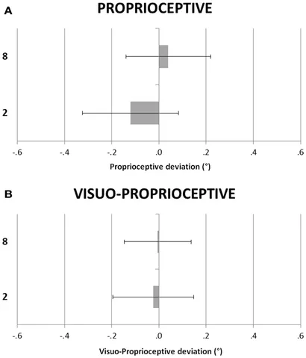
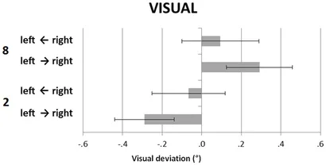
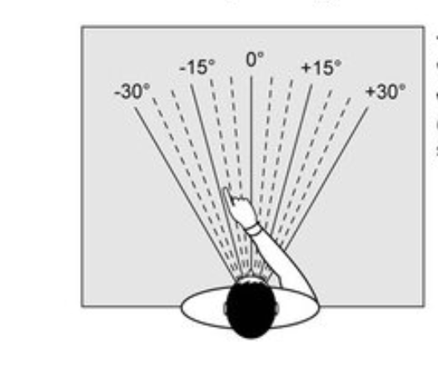
Numbers and Space
Evidence of bidirectional interactions between number processing and spatial attention
Numbers ► Space
If numbers bias spatial attention in extrapersonal, visual coordinates, bodily frames of reference are much more resilient.
Blini, Cattaneo, Vallar, 2013, Frontiers

Slide 5
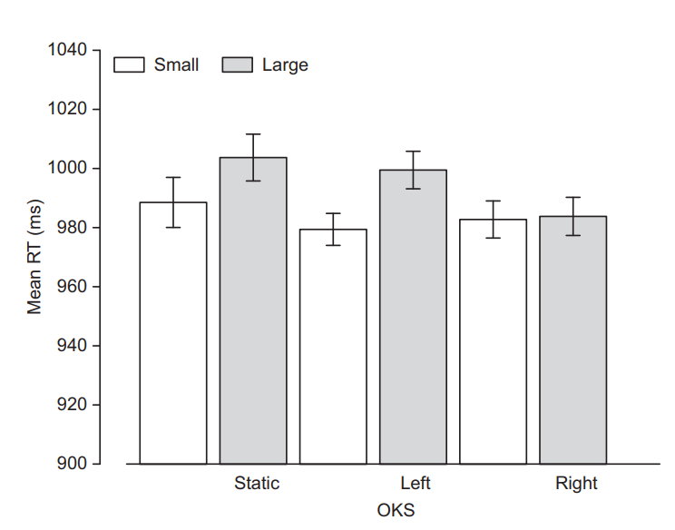
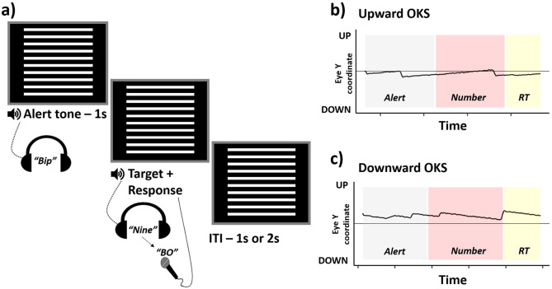
Numbers and Space
Evidence of bidirectional interactions between number processing and spatial attention
Space ► Numbers
Overt biases of spatial attention (i.e., via optokinetic stimulation) result in specific signatures in numerical and arithmetic tasks.
Ranzini et al., 2015, J Cogn Psych;
Blini, Pitteri, Zorzi, 2019, Psych Res;
Felisatti et al., 2022, Cognition

Slide 6
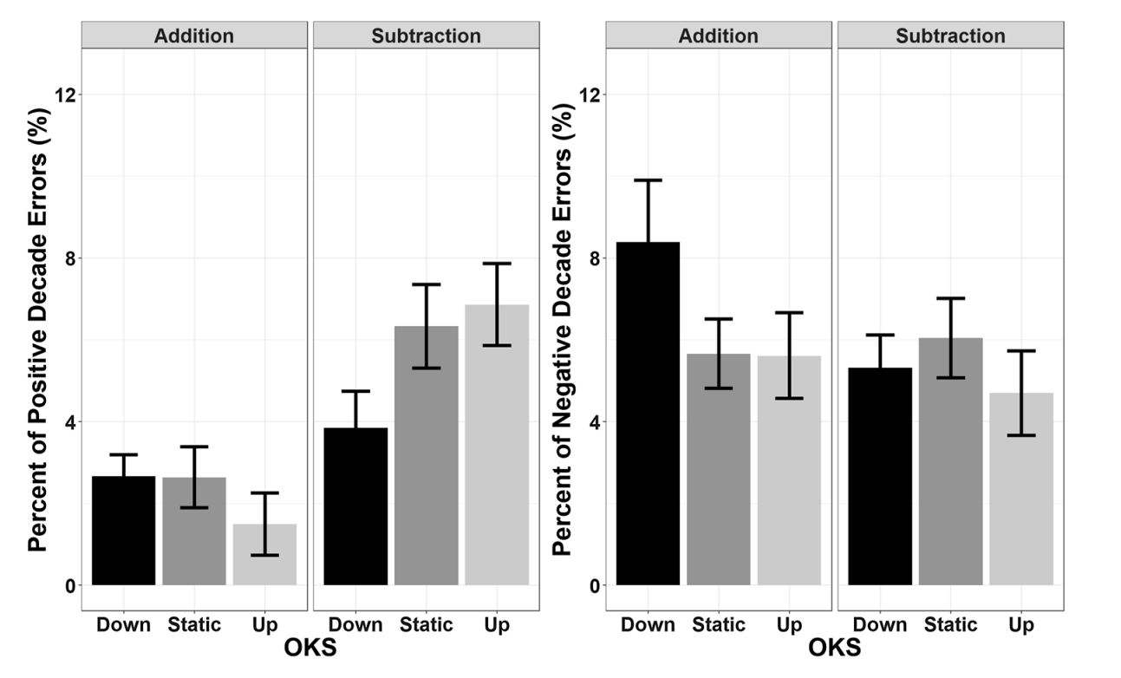
Numbers and Space
Evidence of bidirectional interactions between number processing and spatial attention
Space ► Numbers
Overt biases of spatial attention (i.e., via optokinetic stimulation) result in specific signatures in numerical and arithmetic tasks.
Ranzini et al., 2015, J Cogn Psych;
Blini, Pitteri, Zorzi, 2019, Psych Res;
Felisatti et al., 2022, Cognition

Slide 7
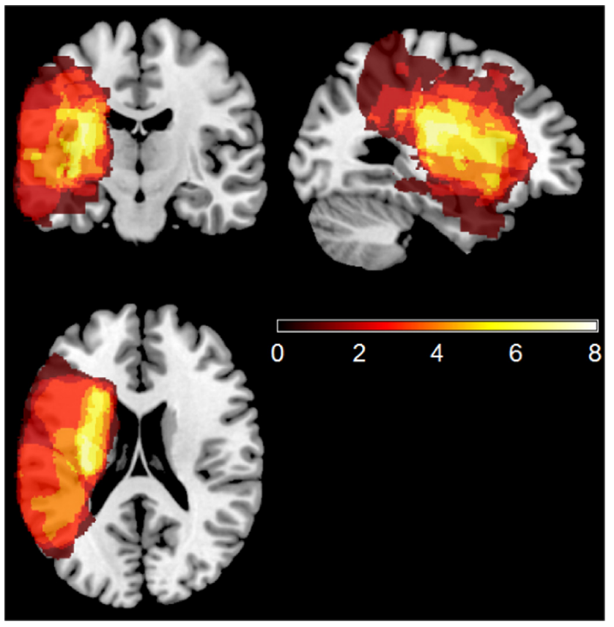
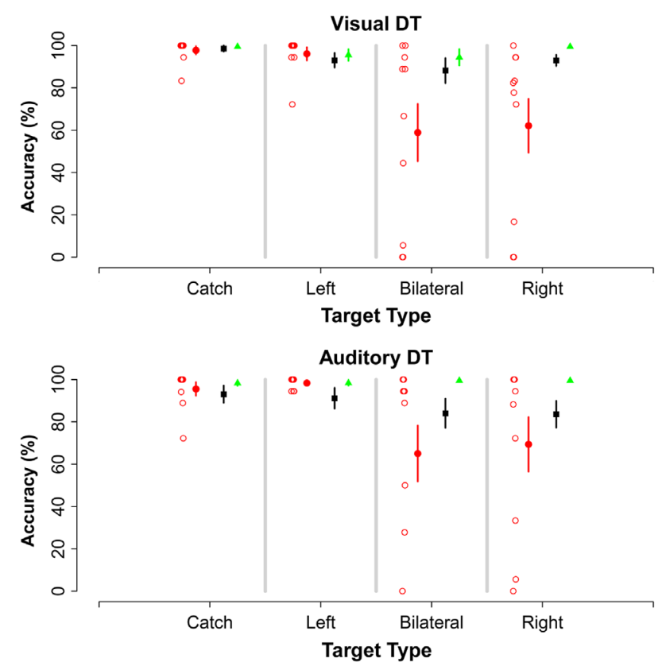
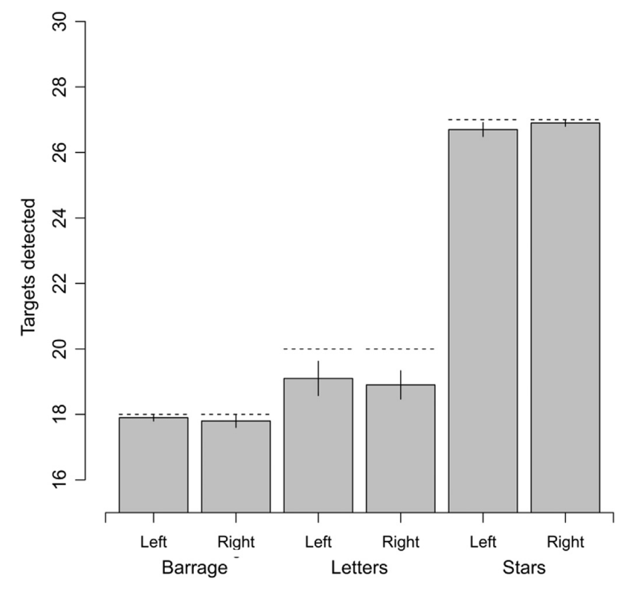
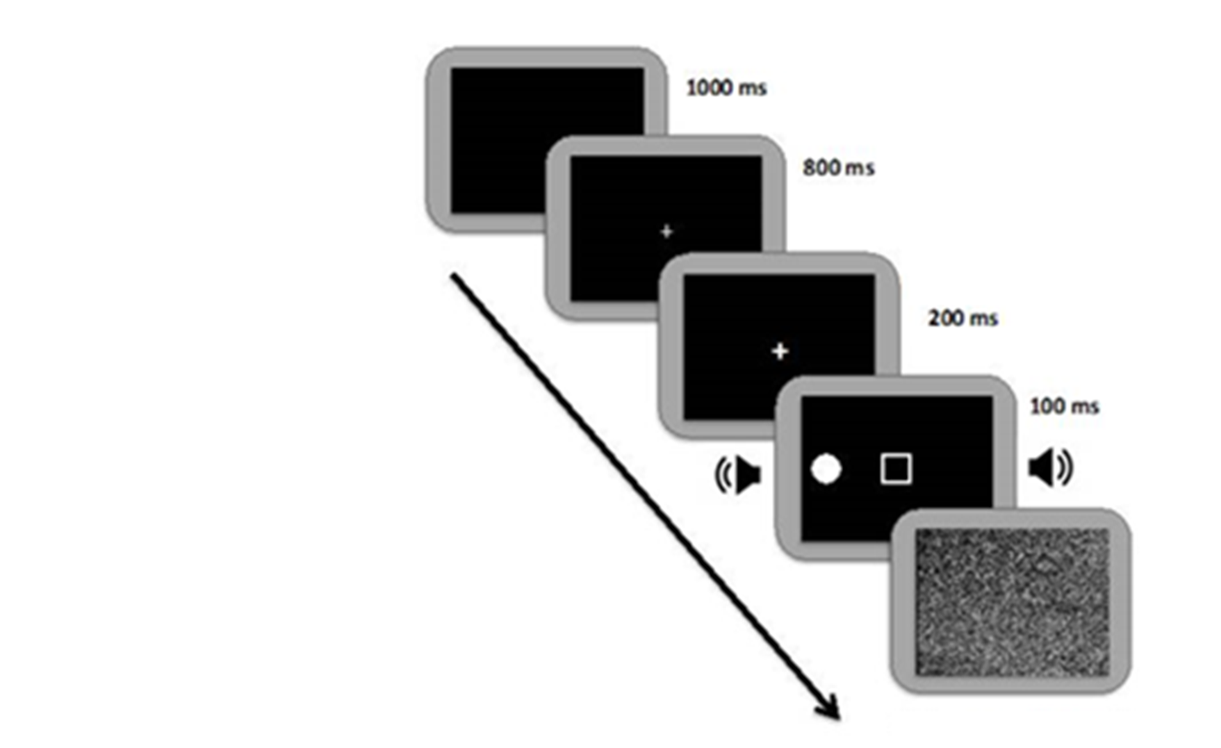
Spatial Neglect
Evidence of both spatial and non-spatial deficits of attention in spatial neglect: implications for more prognostic tests
LHD Stroke
MCI
Controls
Multitasking, regardless of the modality, depletes attentional resources and reveals dormant deficits even in chronic, left-hemisphere stroke patients without neglect according to established diagnostic batteries.
Blini et al., 2016, Neuropsychologia
Blini et al., 2023, BiorXiv

Slide 8
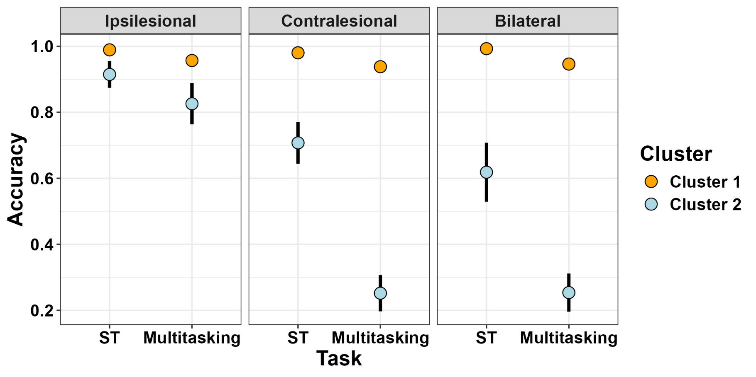
Spatial Neglect
Evidence of both spatial and non-spatial deficits of attention in spatial neglect: implications for more prognostic tests
Multitasking, regardless of the modality, depletes attentional resources and reveals dormant deficits even in chronic, left-hemisphere stroke patients without neglect according to established diagnostic batteries.
Confirmed in a large sample of consecutive stroke patients (N= 46). Scores at this test predict well functional deficits in ecological tests. Lesion and structural disconnection correlates in the Multiple Demands network.
Blini et al., 2016, Neuropsychologia
Blini et al., 2023, BiorXiv

Slide 9
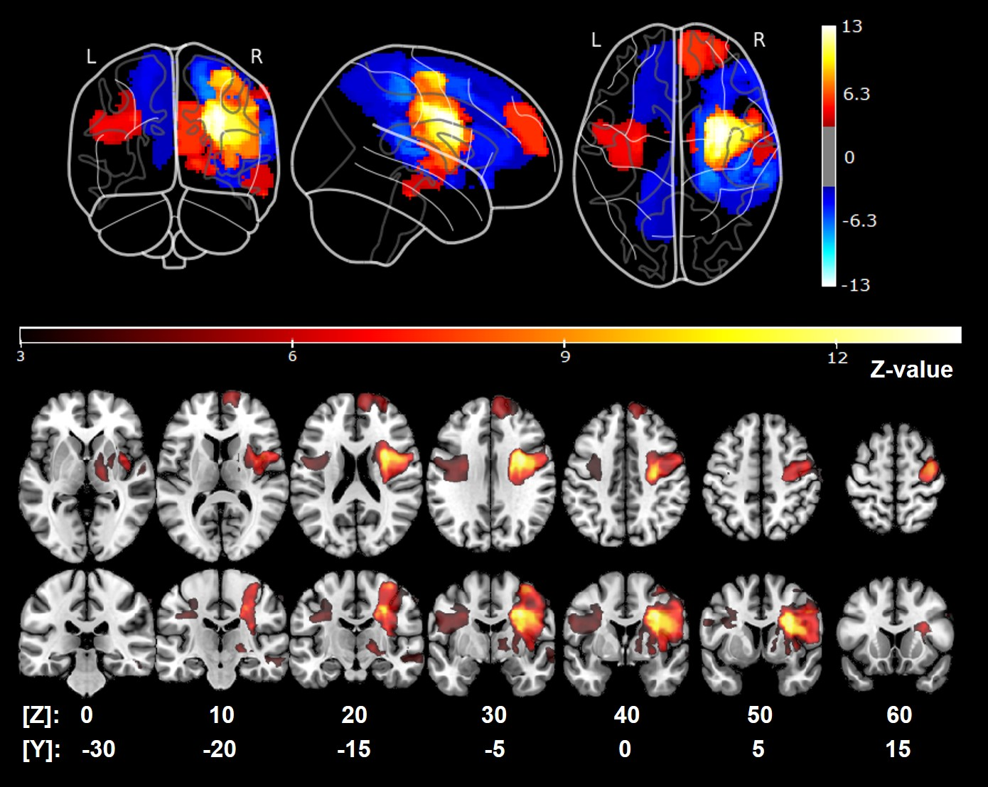
ML for neuroimaging
Evidence of both spatial and non-spatial deficits of attention in spatial neglect: implications for more prognostic tests
Multitasking, regardless of the modality, depletes attentional resources and reveals dormant deficits even in chronic, left-hemisphere stroke patients without neglect according to established diagnostic batteries.
Confirmed in a large sample of consecutive stroke patients (N= 46). Scores at this test predict well functional deficits in ecological tests. Lesion and structural disconnection correlates in the Multiple Demands network.
Blini et al., 2016, Neuropsychologia
Blini et al., 2023, BiorXiv

Slide 10
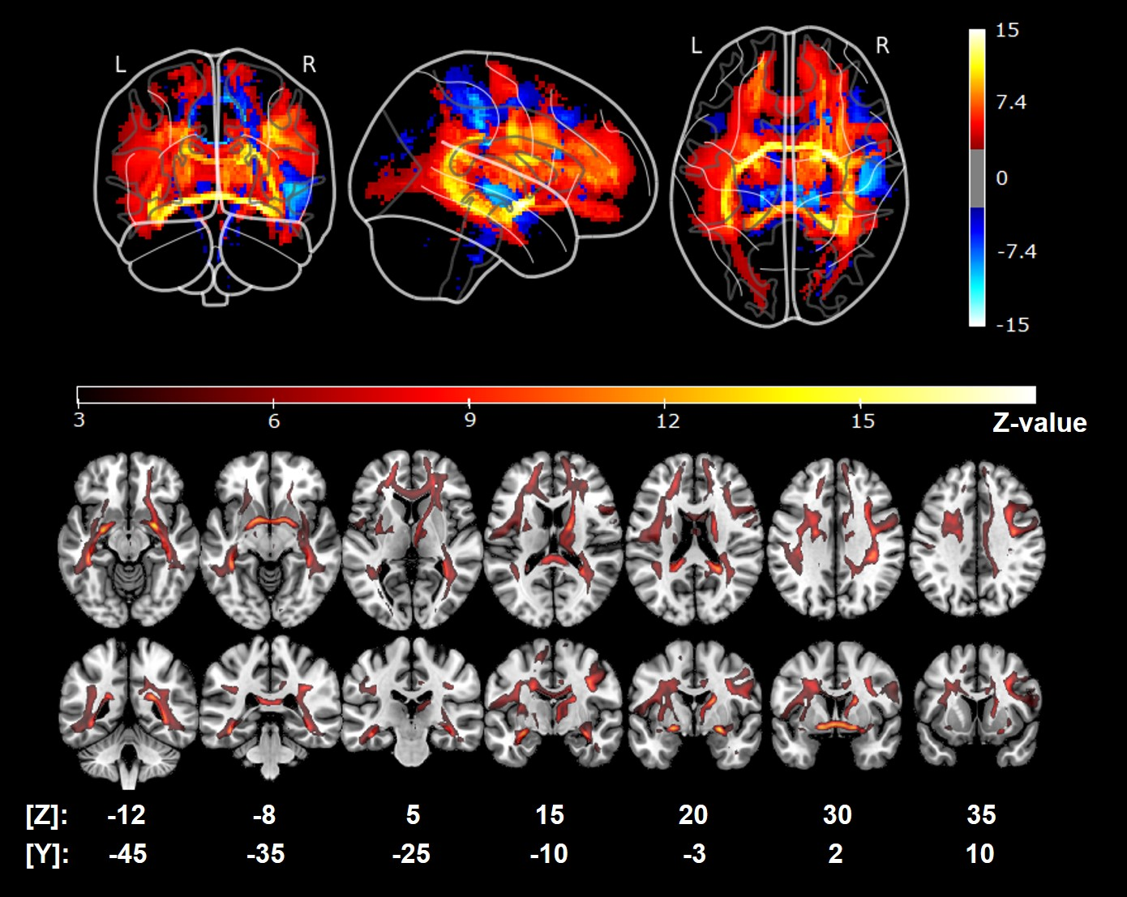
ML for neuroimaging
Evidence of both spatial and non-spatial deficits of attention in spatial neglect: implications for more prognostic tests
Multitasking, regardless of the modality, depletes attentional resources and reveals dormant deficits even in chronic, left-hemisphere stroke patients without neglect according to established diagnostic batteries.
Confirmed in a large sample of consecutive stroke patients (N= 46). Scores at this test predict well functional deficits in ecological tests. Lesion and structural disconnection correlates in the Multiple Demands network.
Blini et al., 2016, Neuropsychologia
Blini et al., 2023, BiorXiv

Slide 11
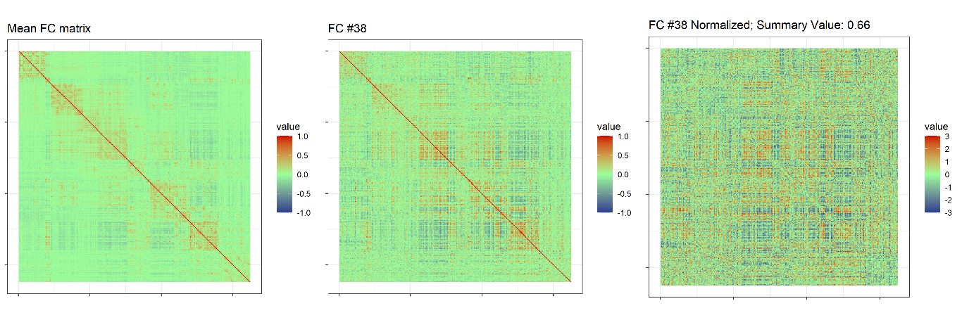
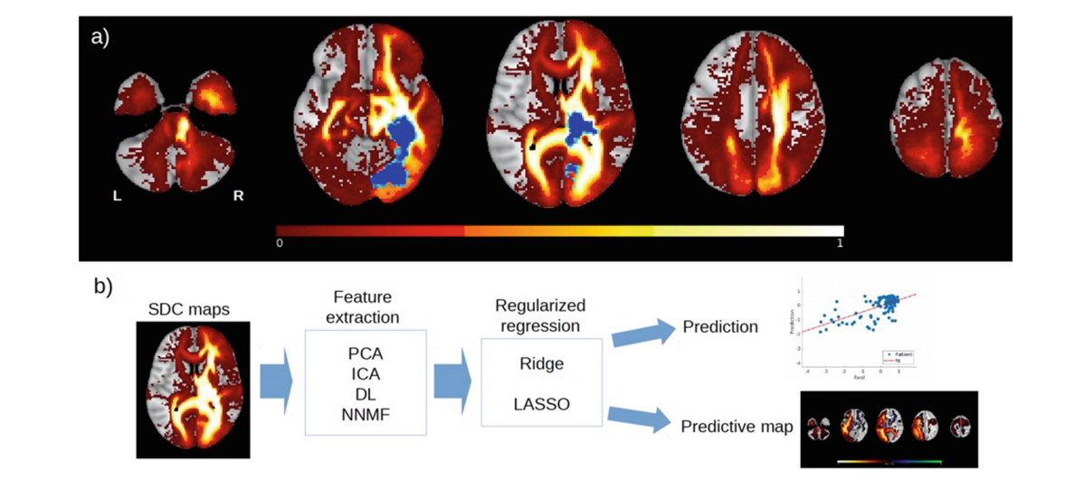
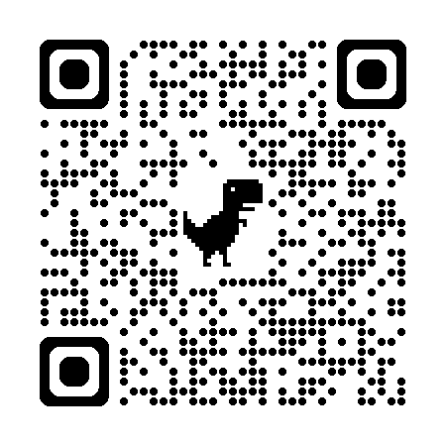

Geek interlude #1
FCnet: A package for the analysis of Functional Connectivity matrices, lesion maps, or disconnection maps through elastic NETs.
Easily implements: feature reduction (PCA and ICA) of resting state matrices, lesion and disconnection maps; hyperparameter tuning through (possibly nested) crossvalidation, and statistical modelling through elastic nets; back-projection onto the original space. Fully open source, it comes with a shiny GUI.
github.com/EBlini

Slide 12
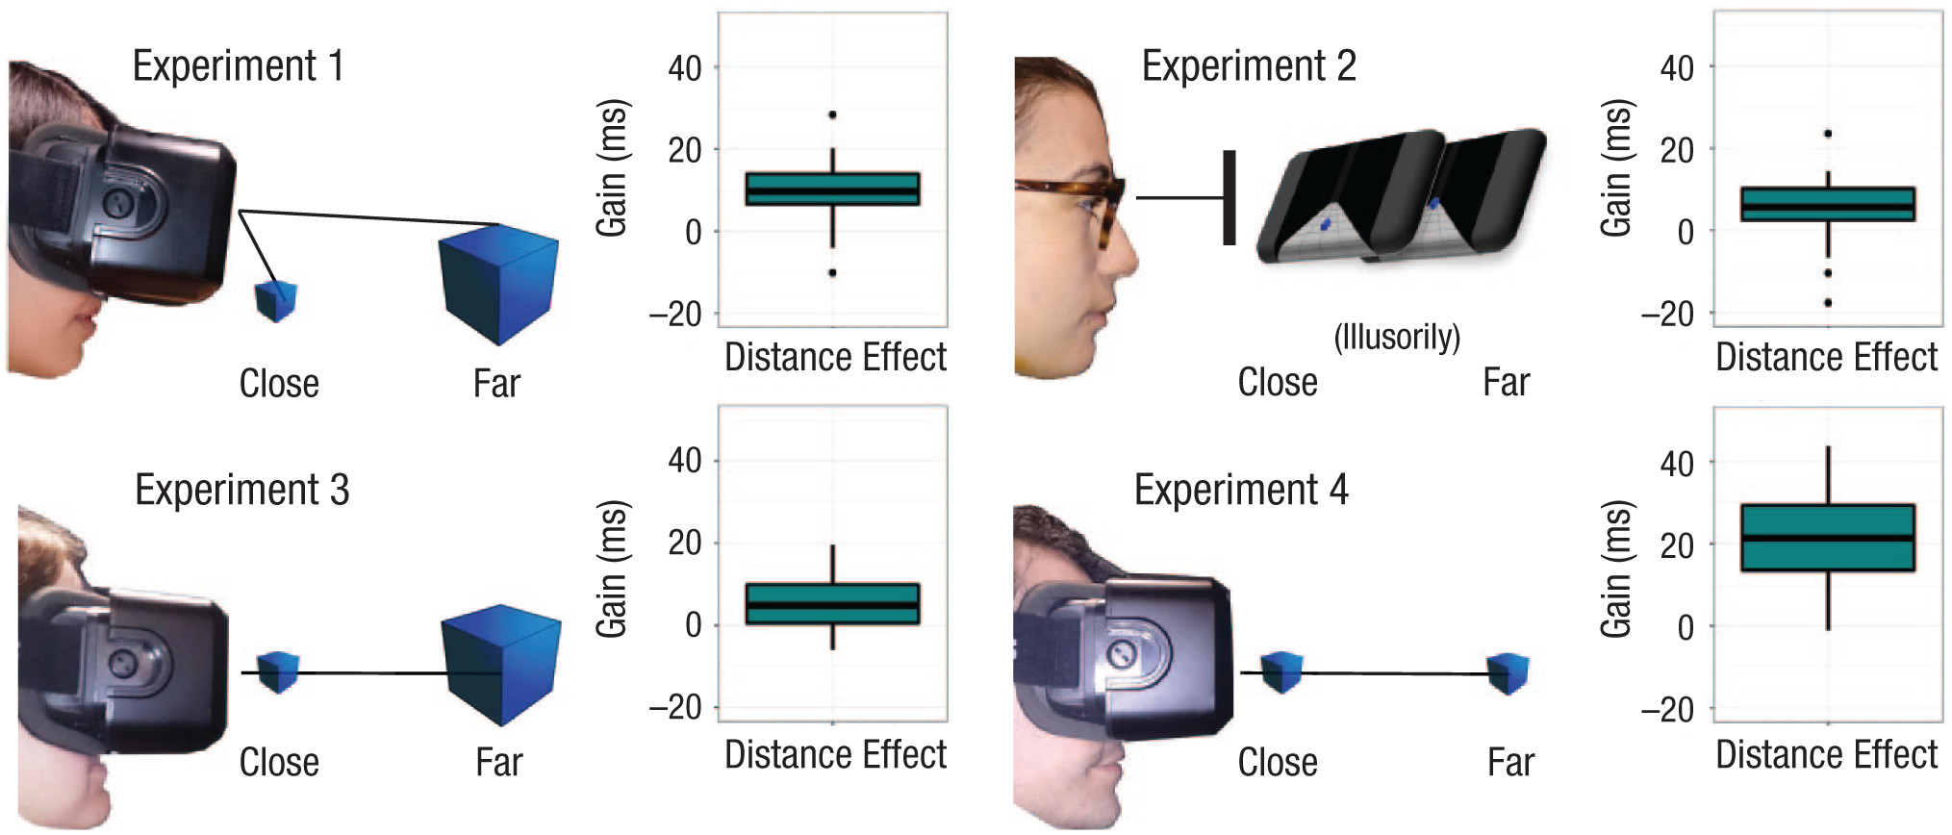
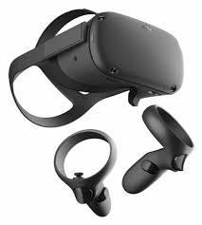
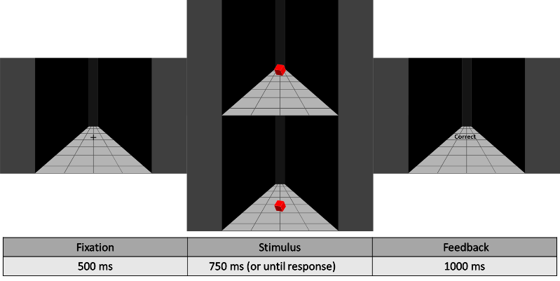
Peripersonal Space
Evidence of enhanced attentional processing close to the body and perceptual (visual) advantages.
We reveal a persistent shape-discrimination advantage for close objects. The advantage does not depend on retinal size; perspectives cues (i.e., Ponzo illusion), and thus illusory distance, are sufficient.
Blini et al., 2018, Psych Sci
Zanini et al., 2021, PBR

Slide 13
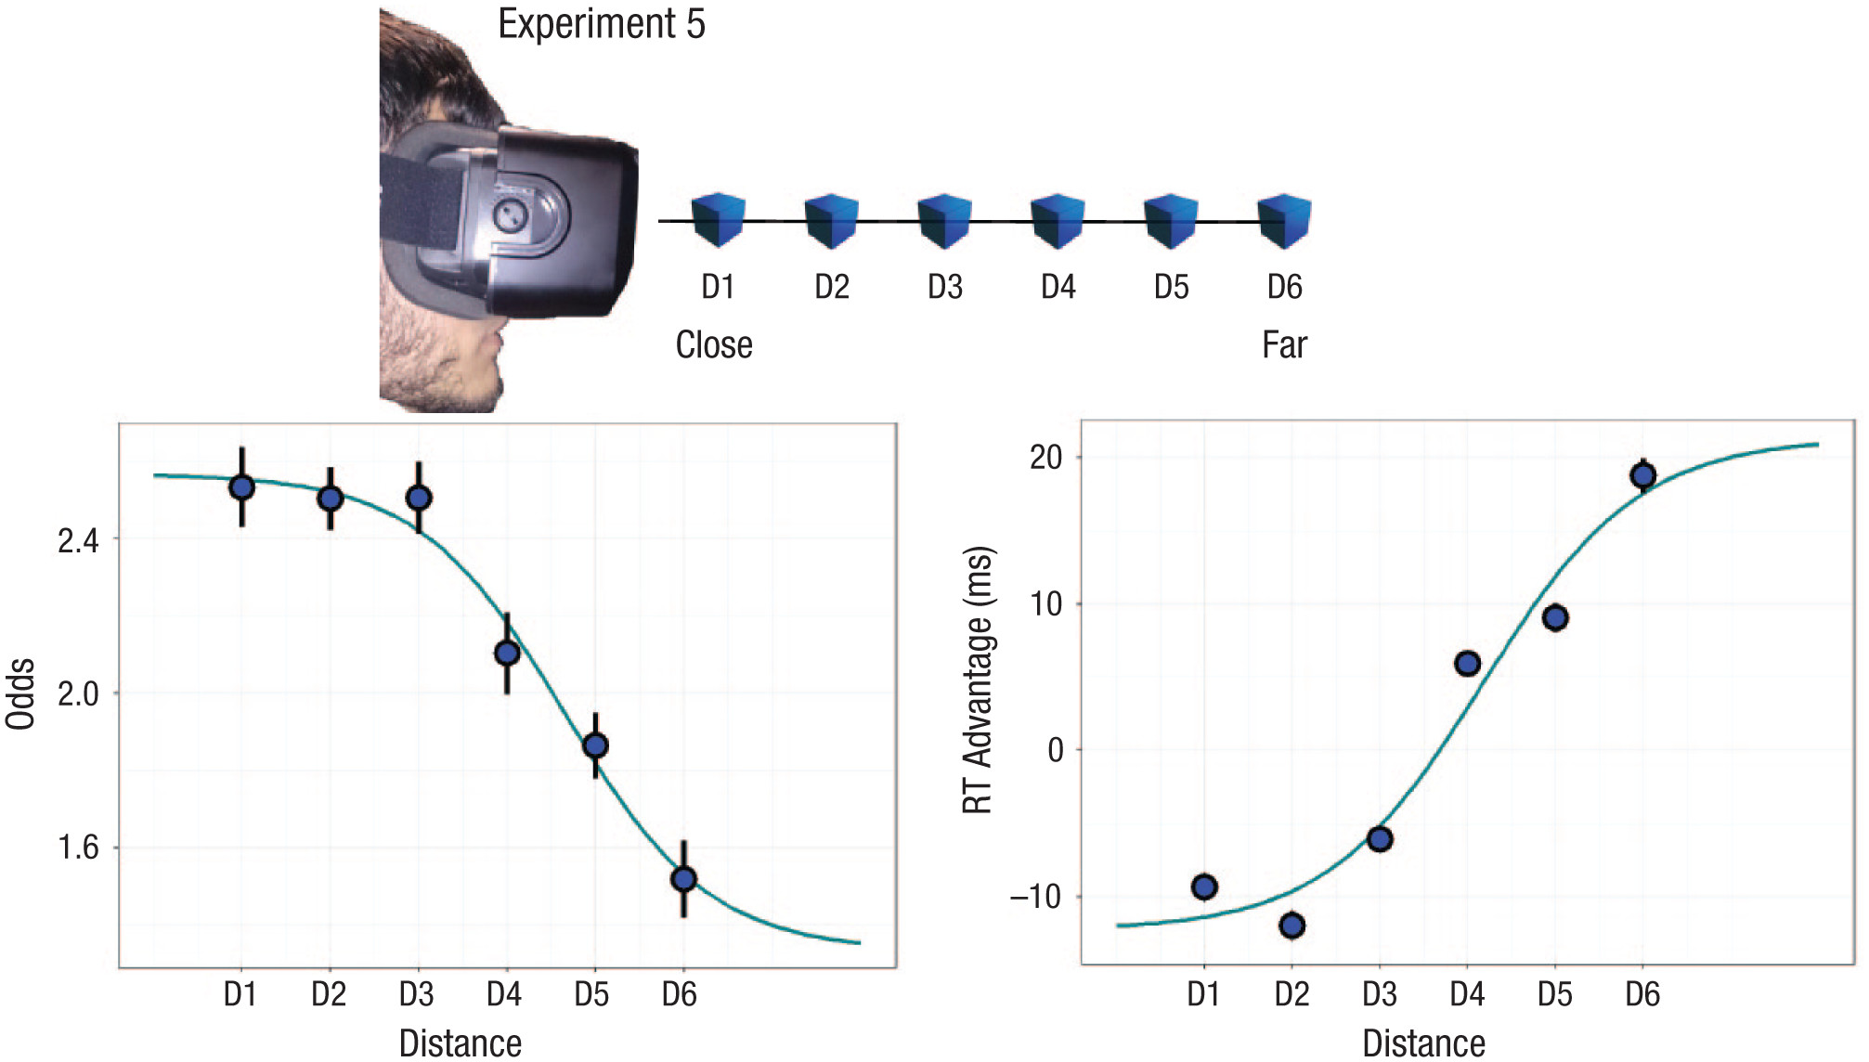
Peripersonal Space
Evidence of enhanced attentional processing close to the body and perceptual (visual) advantages.
We reveal a persistent shape-discrimination advantage for close objects. The advantage does not depend on retinal size; perspectives cues (i.e., Ponzo illusion), and thus illusory distance, are sufficient.
The distance effect follows a sigmoidal trend, which is therefore not a specific signature of multisensory facilitation.
Blini et al., 2018, Psych Sci
Zanini et al., 2021, PBR

Slide 14
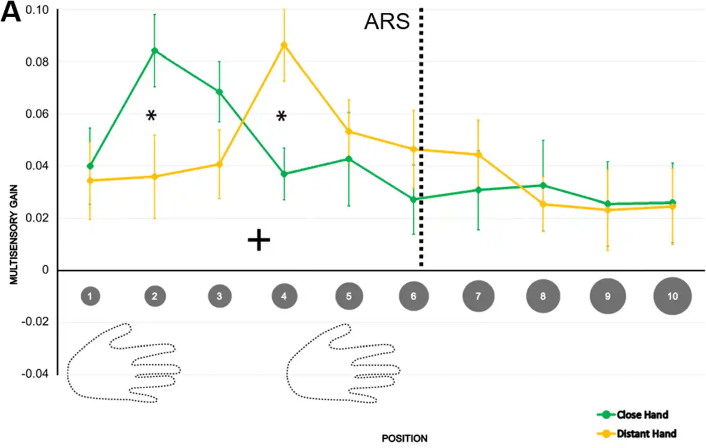
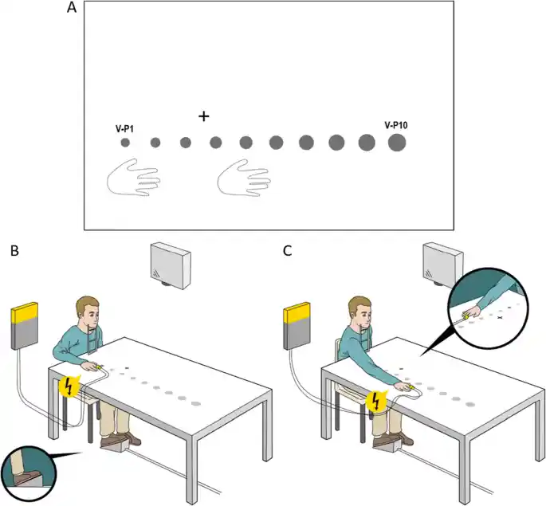
Peripersonal Space
Evidence of enhanced attentional processing close to the body and perceptual (visual) advantages.
We reveal a persistent shape-discrimination advantage for close objects. The advantage does not depend on retinal size; perspectives cues (i.e., Ponzo illusion), and thus illusory distance, are sufficient.
The distance effect follows a sigmoidal trend, which is therefore not a specific signature of multisensory facilitation.
Blini et al., 2018, Psych Sci
Zanini et al., 2021, PBR

Slide 15
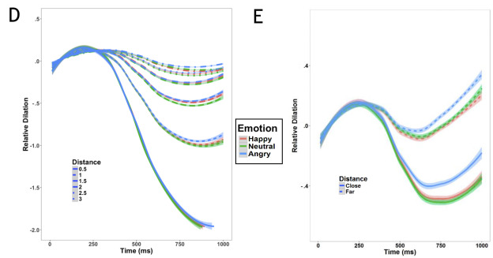
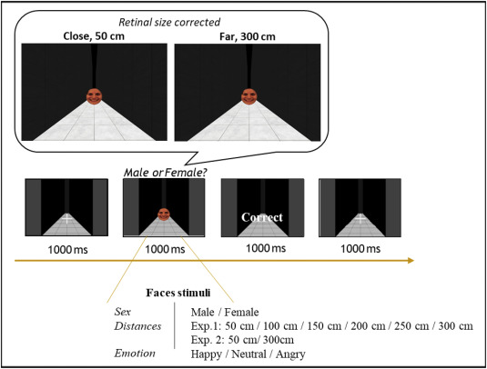
Pupillometry
Evidence of enhanced attentional processing close to the body and perceptual (visual) advantages.
The behavioral advantage for closer stimuli is not limited to simple visual features but extend to complex, social stimuli.
Behavioral effects are accompanied by multiple, complex psychophysiological effects that depend on both distance and the emotional context.
Dureux et al., 2021, Cortex
Blini, Anobile, Arrighi, 2024, Psych Res
Blini, Arrighi, Anobile, 2024, BiorXiv

Slide 16
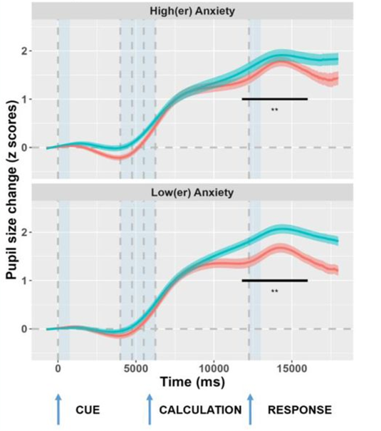
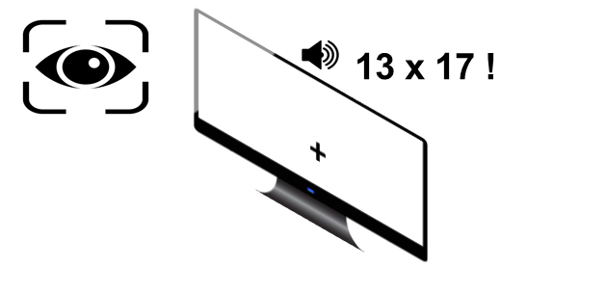
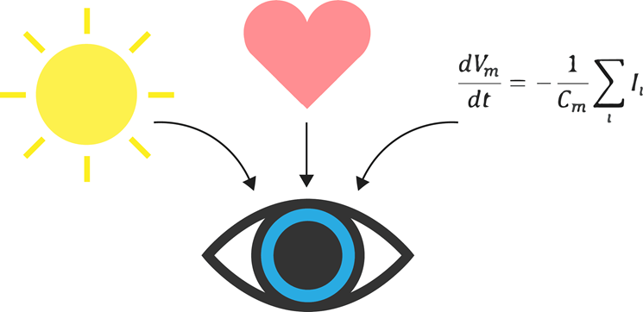
Pupillometry
The measurement of pupil size provides an integrated readout of distinct attentional and cognitive processes.
We recorded pupil size before (anticipation), during (calculation), and after (feedback) mental arithmetic. Pupil dynamics suggest increased cognitive effort in people with high math anxiety. However, the effect is hardly discernible from that of arithmetic performance, indicating that is hard to disentangle emotional aspects from the efficiency in mental calculation.
Dureux et al., 2021, Cortex
Blini, Anobile, Arrighi, 2024, Psych Res
Blini, Arrighi, Anobile, 2024, BiorXiv

Slide 17
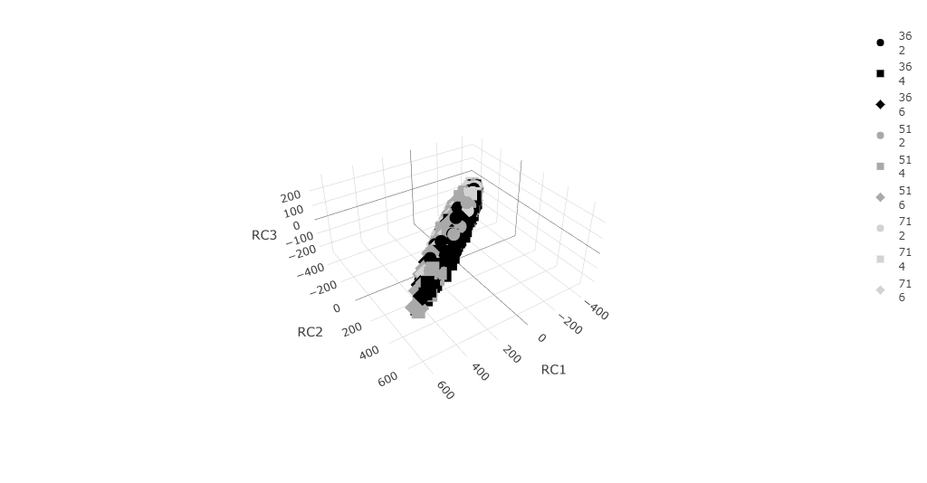
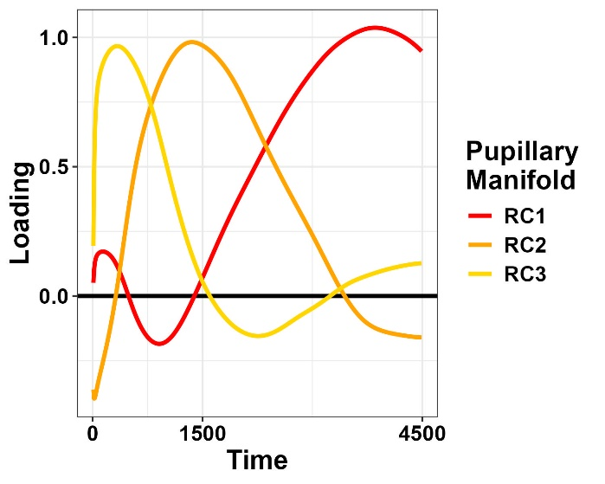
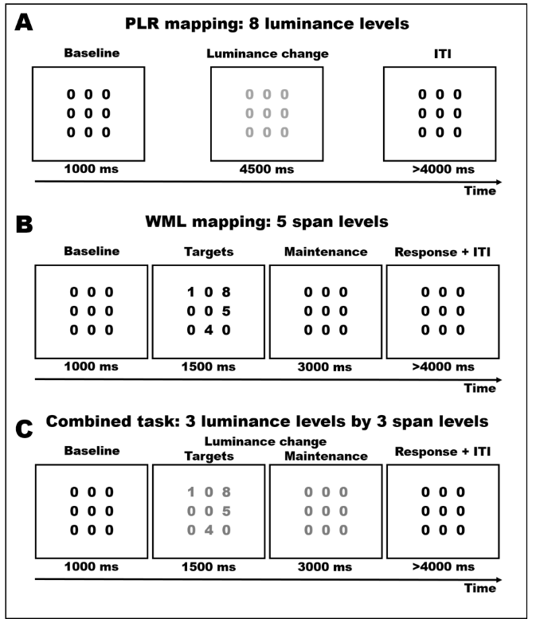
Pupillometry
The measurement of pupil size provides an integrated readout of distinct attentional and cognitive processes.
Luminance
Vs
Memory load
Phasic changes in pupil size are inherently low-dimensional, with modes that are highly consistent across behavioral tasks of very different nature, suggesting that they occur along a pupillary manifold that is highly constrained by the underlying physiology.
Dureux et al., 2021, Cortex
Blini, Anobile, Arrighi, 2024, Psych Res
Blini, Arrighi, Anobile, 2024, BiorXiv

Slide 18
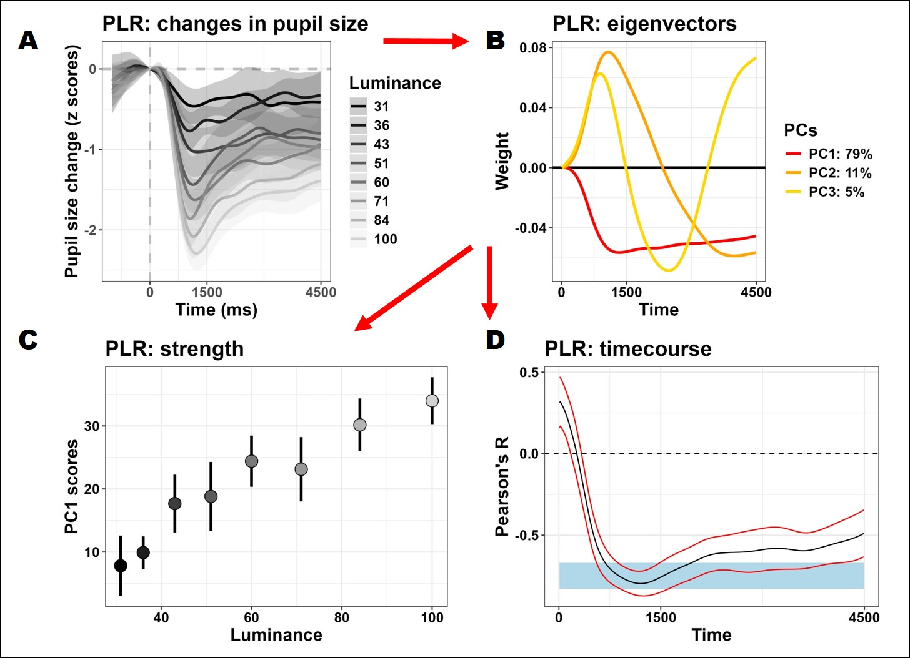
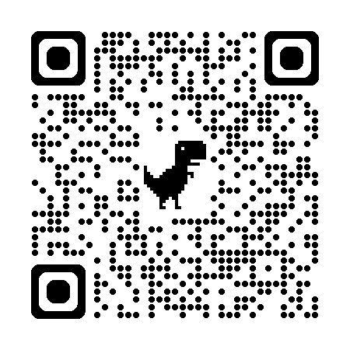
Geek interlude #2
Pupilla: A package for the preprocessing and analysis of eye-tracking and pupillometry data.
Easily implements: data reading and cleaning (artifacts removal, interpolation, smoothing, quality checks); utilities for feature reduction (PCA, rPCA, ICA), including graphical depictions; analysis tools (e.g., crossvalidated LMEMs).
github.com/EBlini

Slide 19
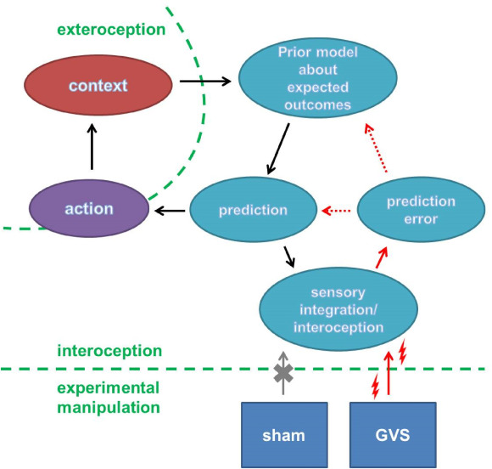

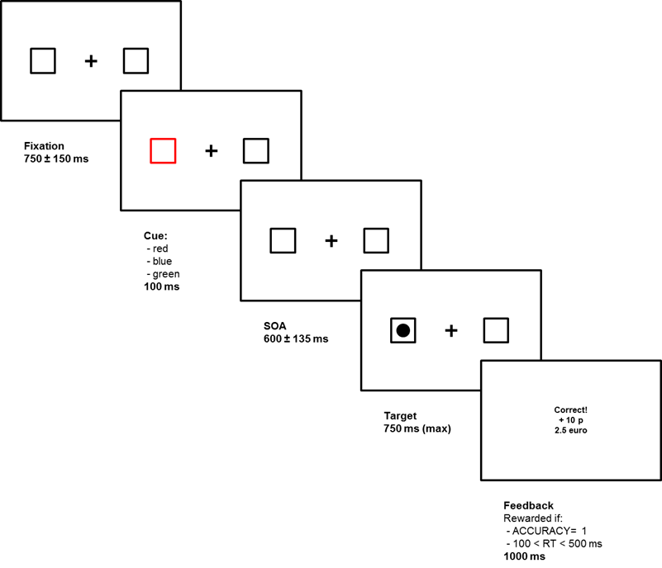

Interoception and motivation
There is a tight link between bodily states and motivational assets. Vestibular stimulation is a safe tool to probe this dialogue causally.
Project:
BRAVEST
Galvanic Vestibular Stimulation (GVS) induces sensory, vestibular mismatches: illusions of self-movement in spite of constant visual stimulation.
Vestibular mismatches impact motivational assets by decreasing sensitivity to rewards.
Left-Anodal SHAM Right-Anodal
Blini et al., 2018, Cortex
Blini et al., 2020, Cortex

Slide 20
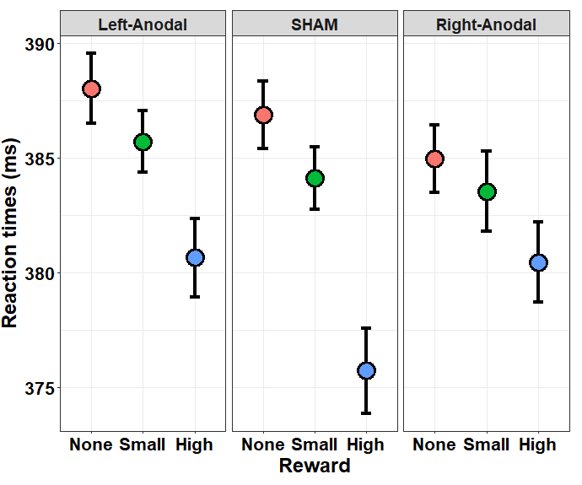
Interoception and motivation
There is a tight link between bodily states and motivational assets. Vestibular stimulation is a safe tool to probe this dialogue causally.
Project:
BRAVEST
Galvanic Vestibular Stimulation (GVS) induces sensory, vestibular mismatches: illusions of self-movement in spite of constant visual stimulation.
Vestibular mismatches impact motivational assets by decreasing sensitivity to rewards.
Left-Anodal SHAM Right-Anodal
Blini et al., 2018, Cortex
Blini et al., 2020, Cortex

Slide 21
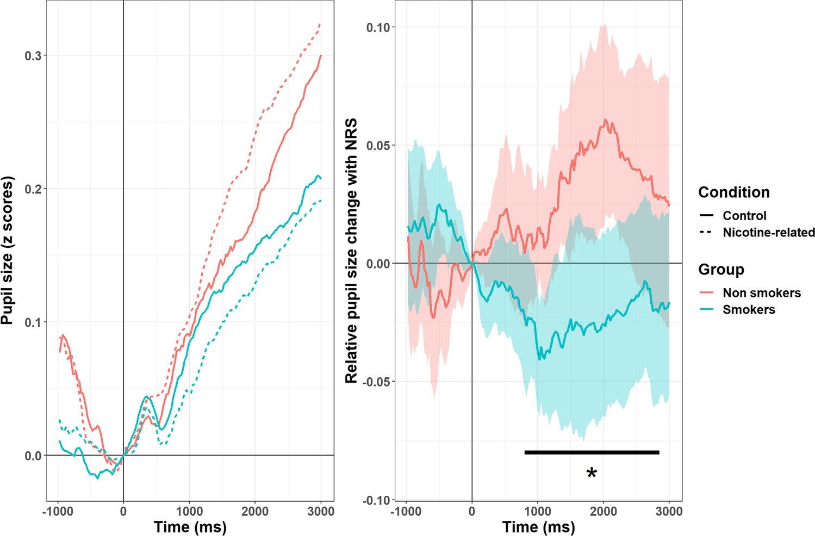

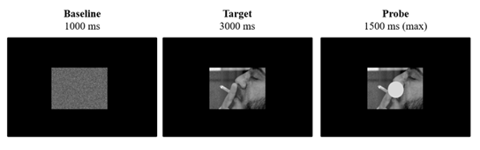
In the future…
Subjective salience (and craving) can be measured objectively with pupillometry: enhanced Pupil Light Response is smokers viewing nicotine-related stimuli.
Project:
HARVEST
Pupil dilation is an excellent index of classic conditioning. However, subjective salience and craving can also result in much more subtle modulations of the pupil light response (due, e.g., to enhanced attention or biases toward central acuity).
Blini, Zorzi, 2023, PBR

Slide 22

In the future…
Subjective salience (and craving) can be measured objectively with pupillometry: enhanced Pupil Light Response is smokers viewing nicotine-related stimuli.
Project:
BEST-VS
Left-Anodal SHAM Right-Anodal
Pupil dilation is an excellent index of classic conditioning. However, subjective salience and craving can also result in much more subtle modulations of the pupil light response (due, e.g., to enhanced attention or biases toward central acuity).
Are the effects of GVS mediated by autonomic activity? What are the neural substrates of these autonomic fingerprints?
Road to PNRR YoungResearchers 2024…

Slide 23





Thank you!
elvioadalberto.blini@unifi.it

